Slide 1


Design presentation
Bennet Hörmann, Salomo Hummel, Simeon Schrape, Erik Wu, Udo Zucker

Slide 2
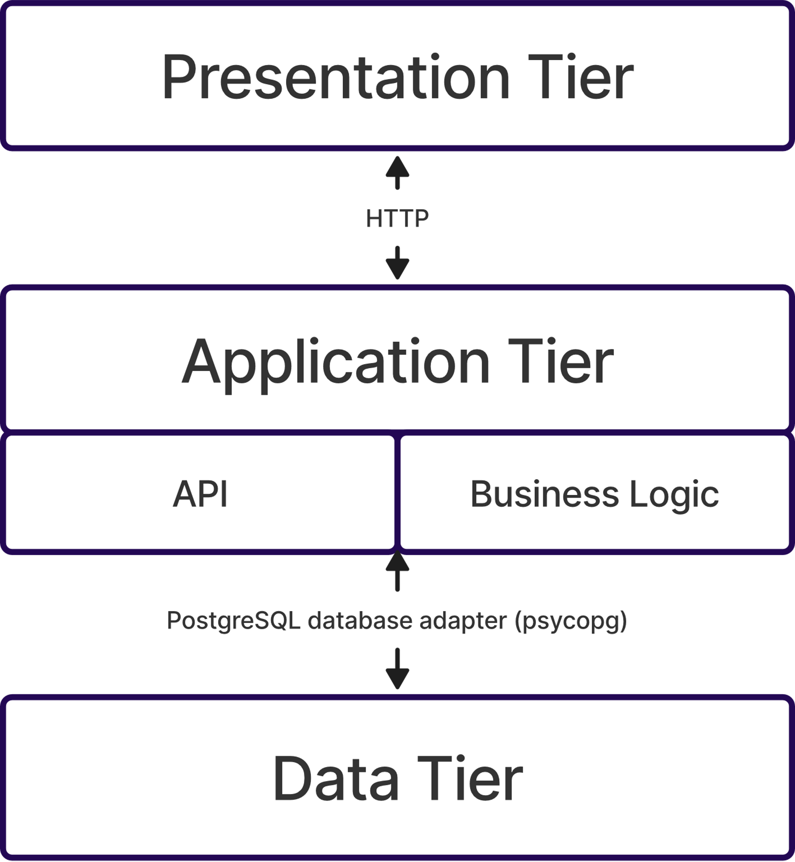
Basic structure – 3 Tier Architecture

Slide 3
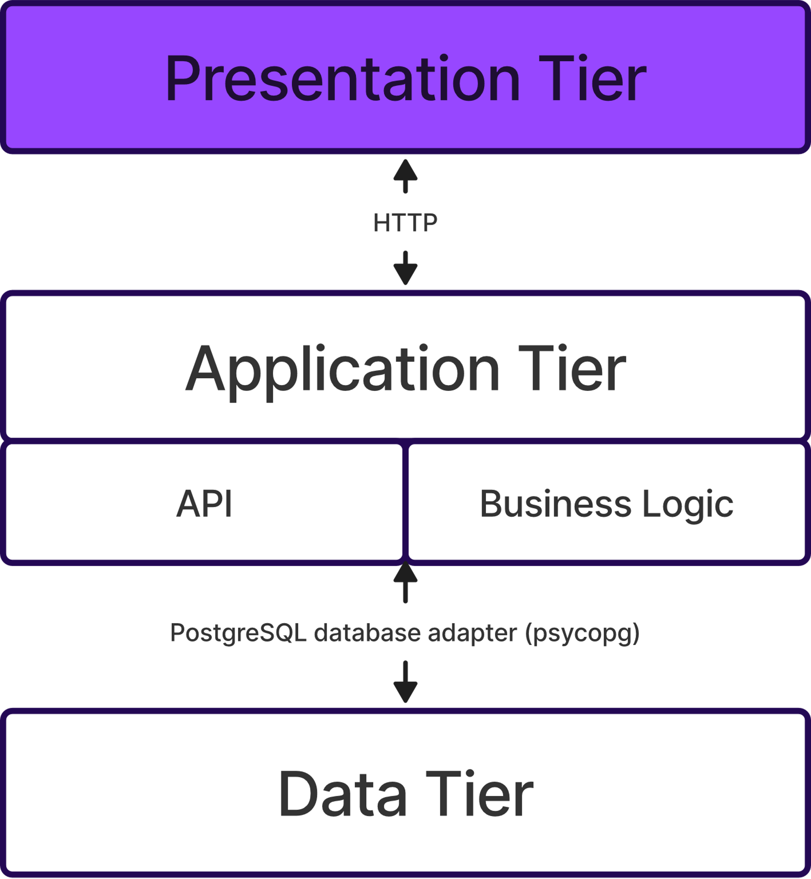
3 Tier Architecture – Presentation Tier

Slide 4
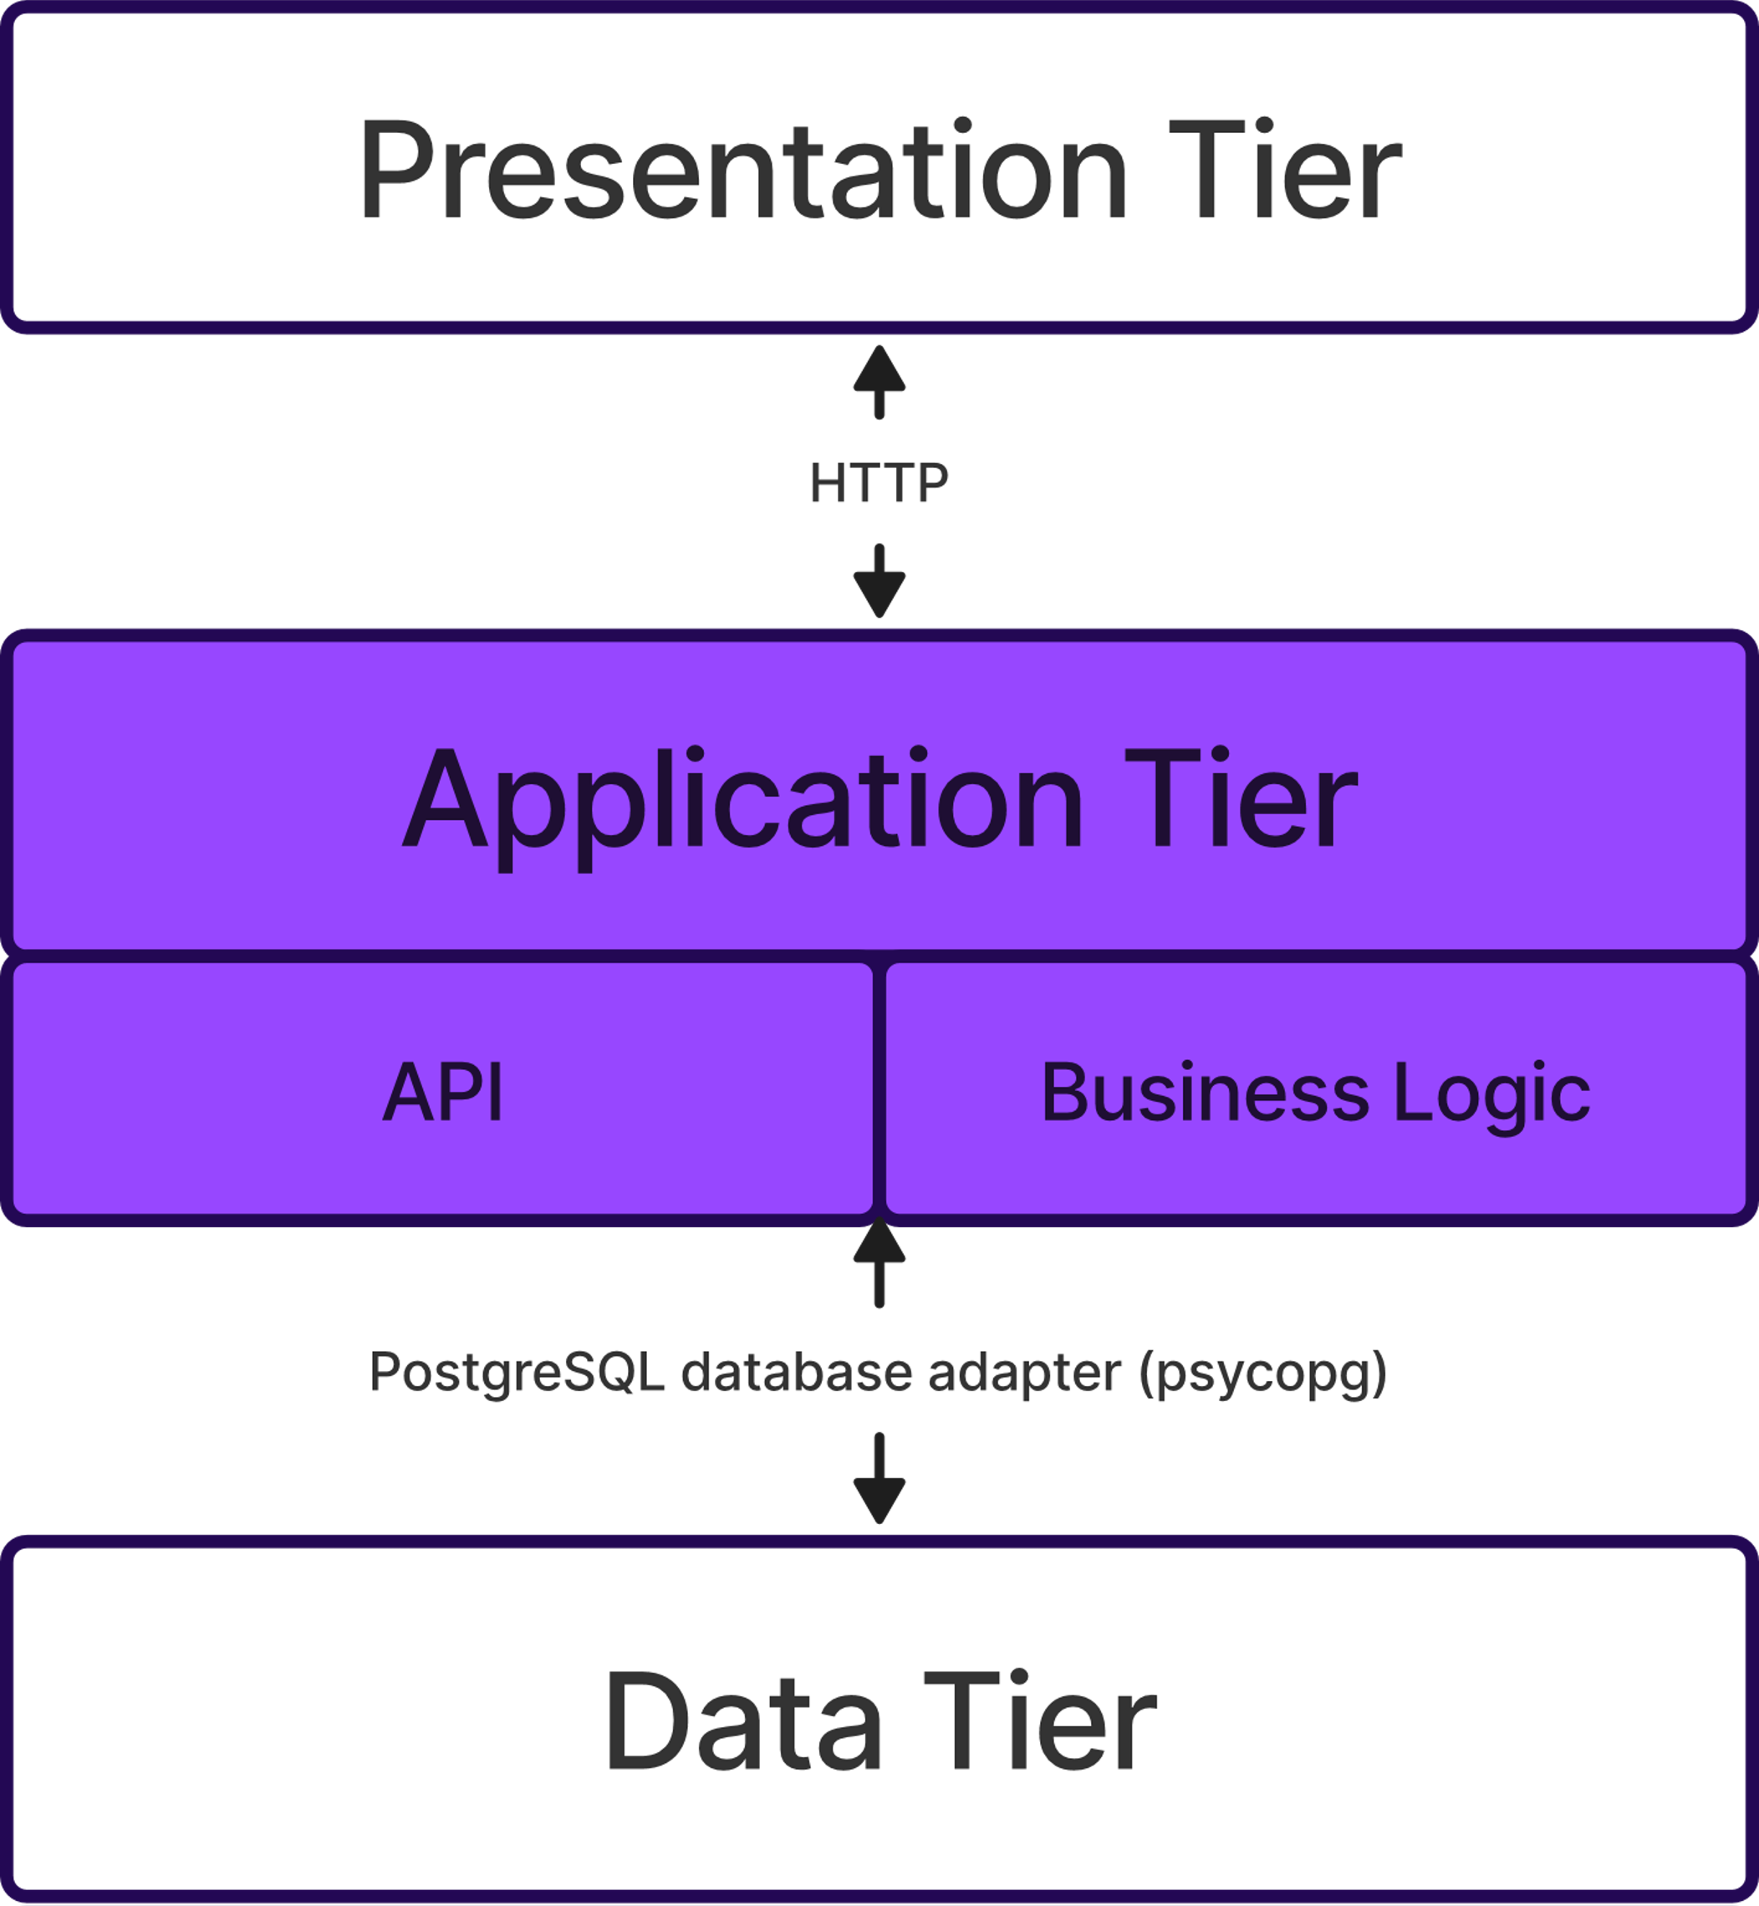
3 Tier Architecture – Application Tier

Slide 5
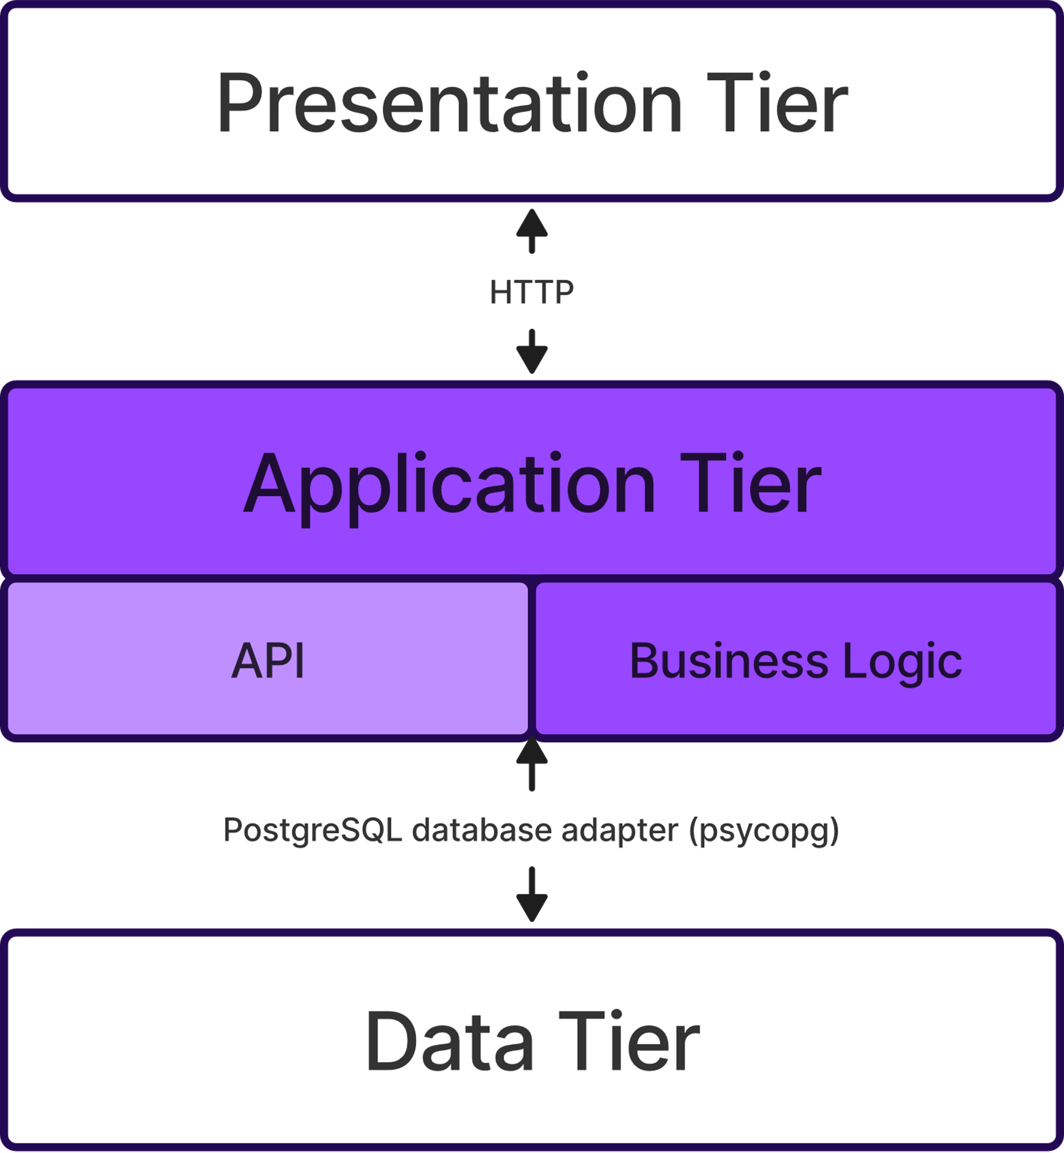
3 Tier Architecture – Application Tier (API)

Slide 6
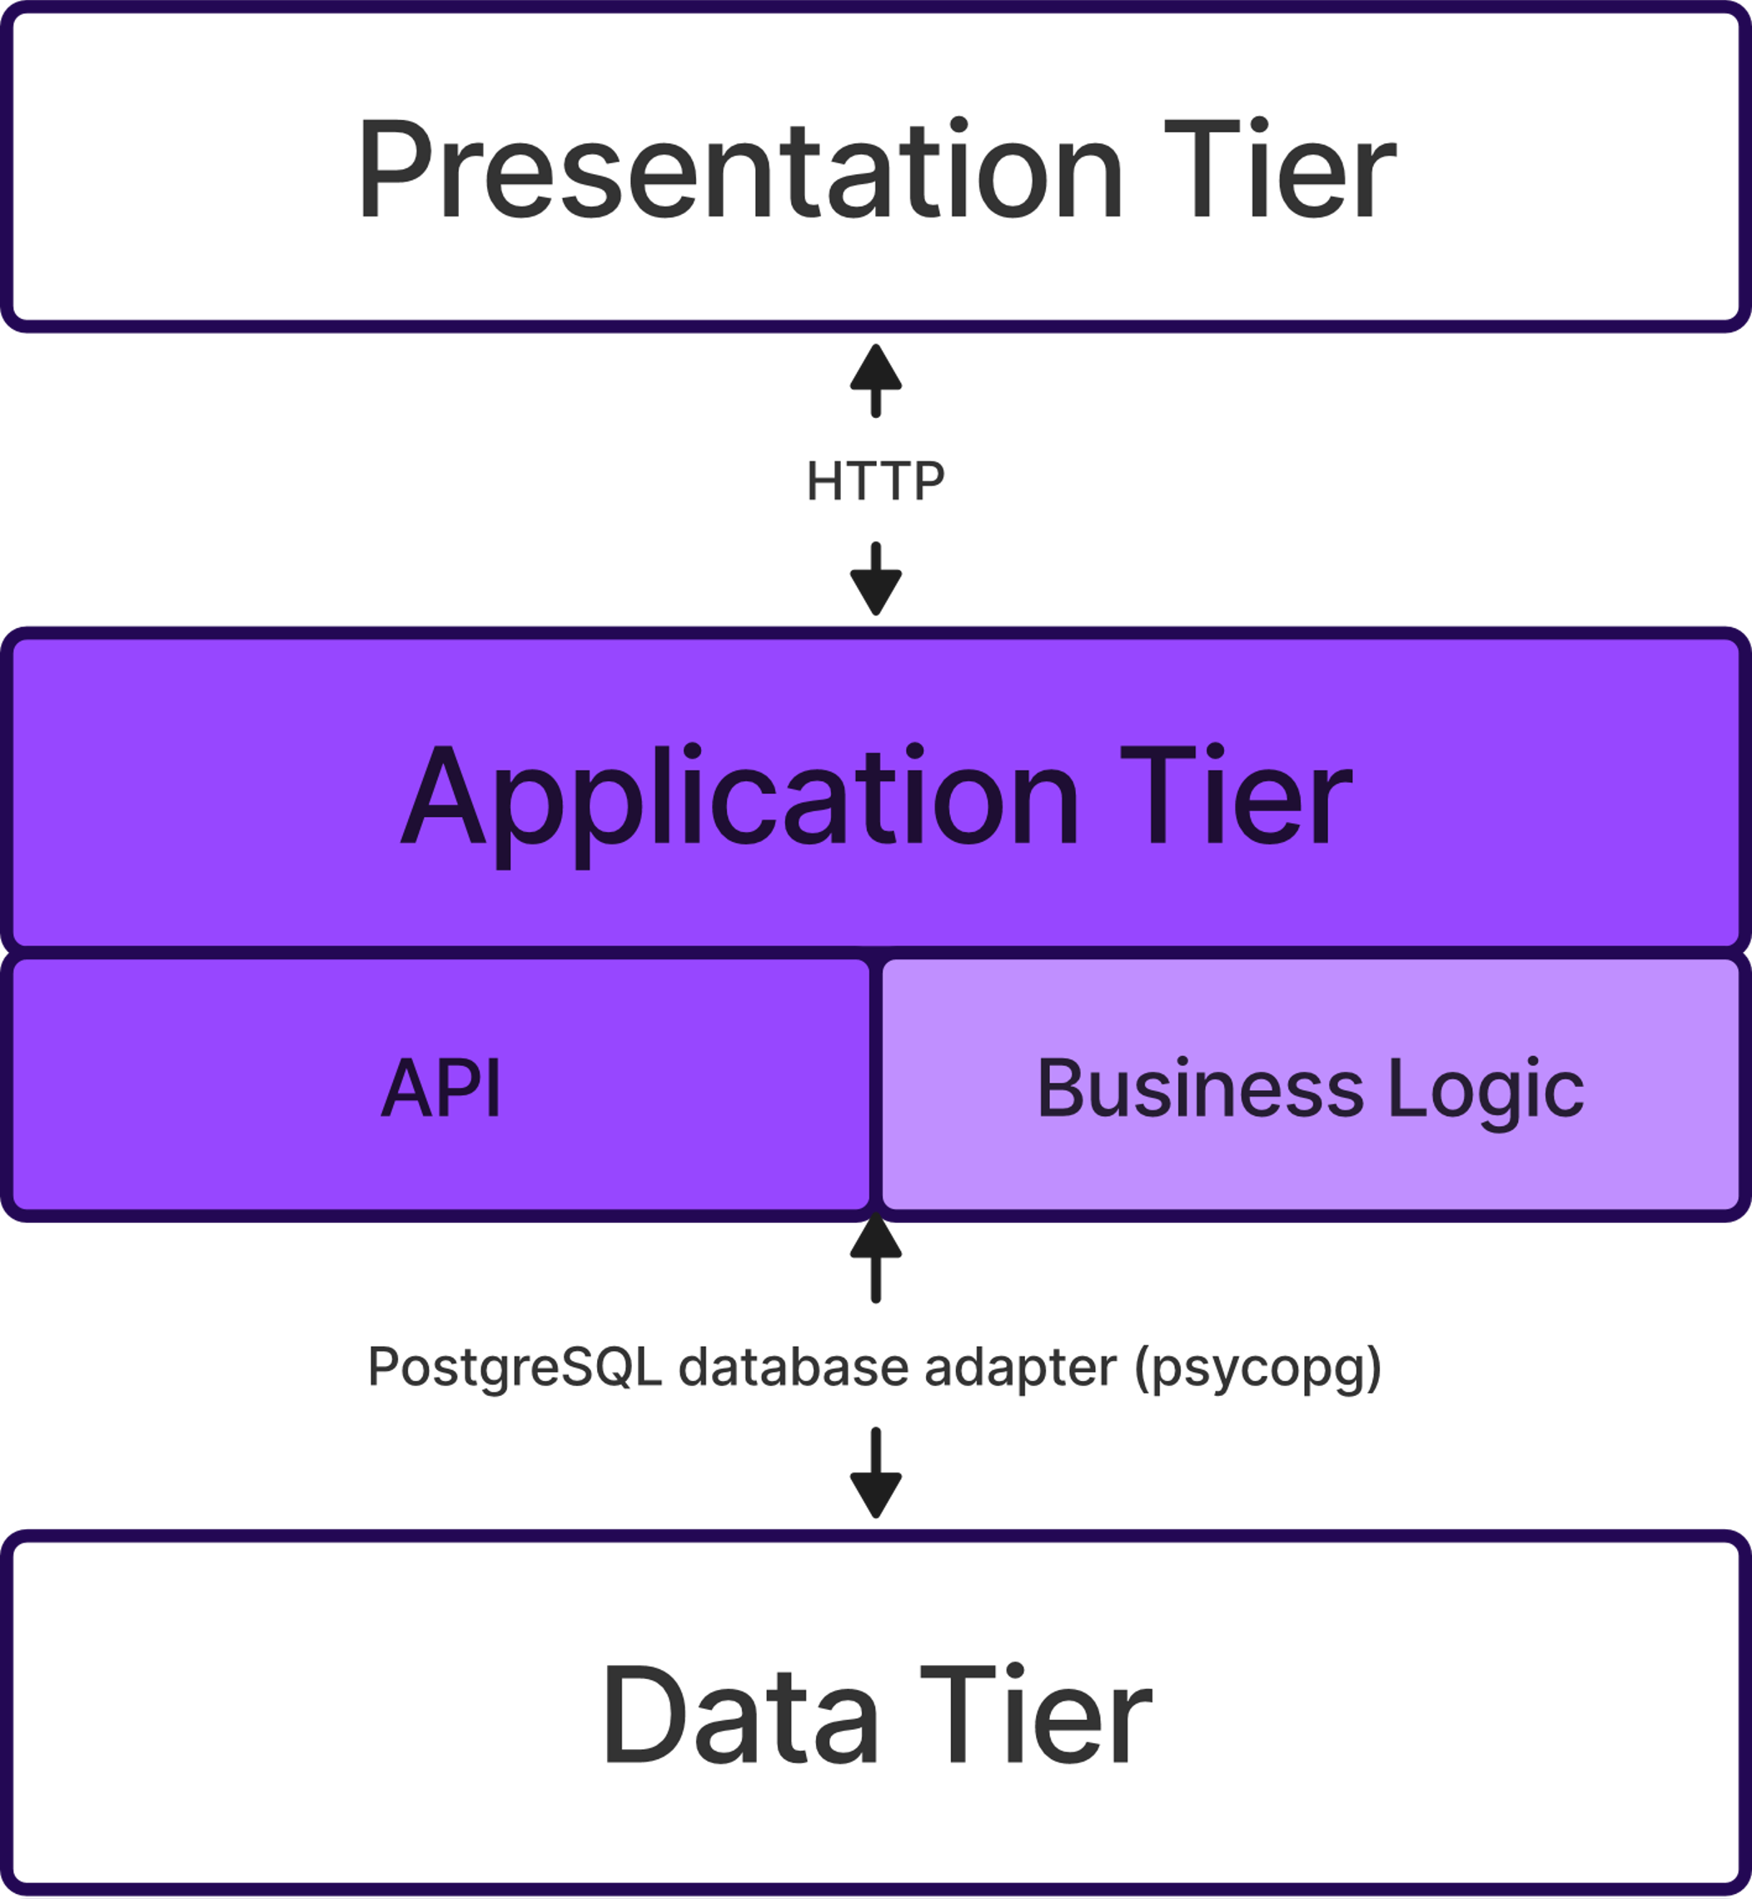
3 Tier Architecture – Application Tier (Business Logic)

Slide 7
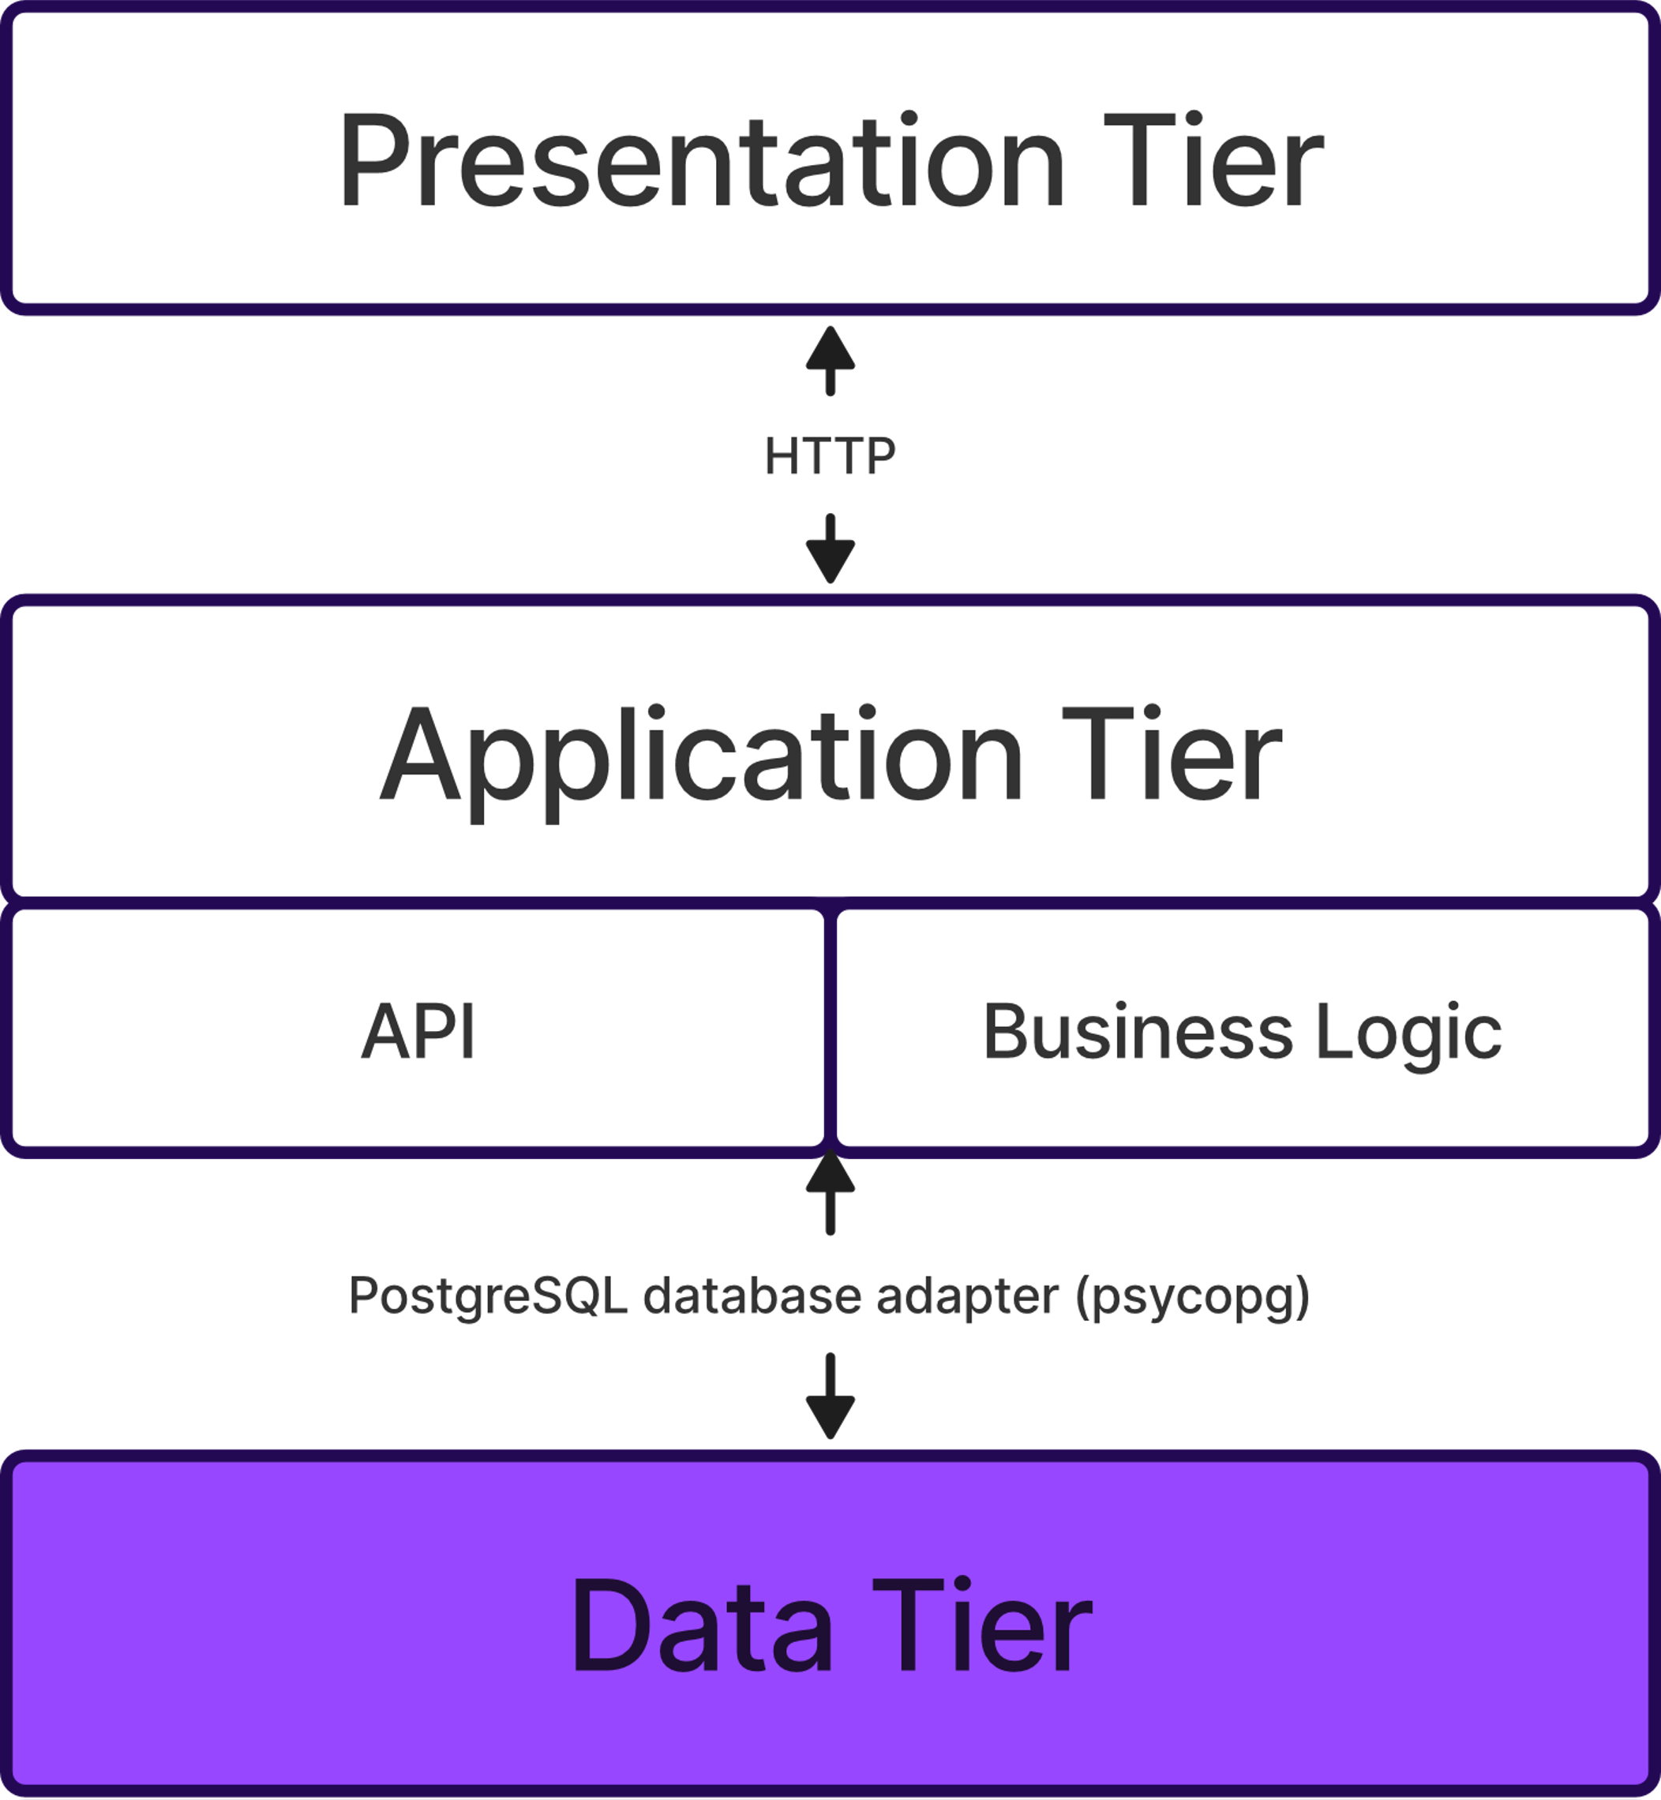
3 Tier Architecture – Data Tier

Slide 8
3 Tier Architecture

Slide 9
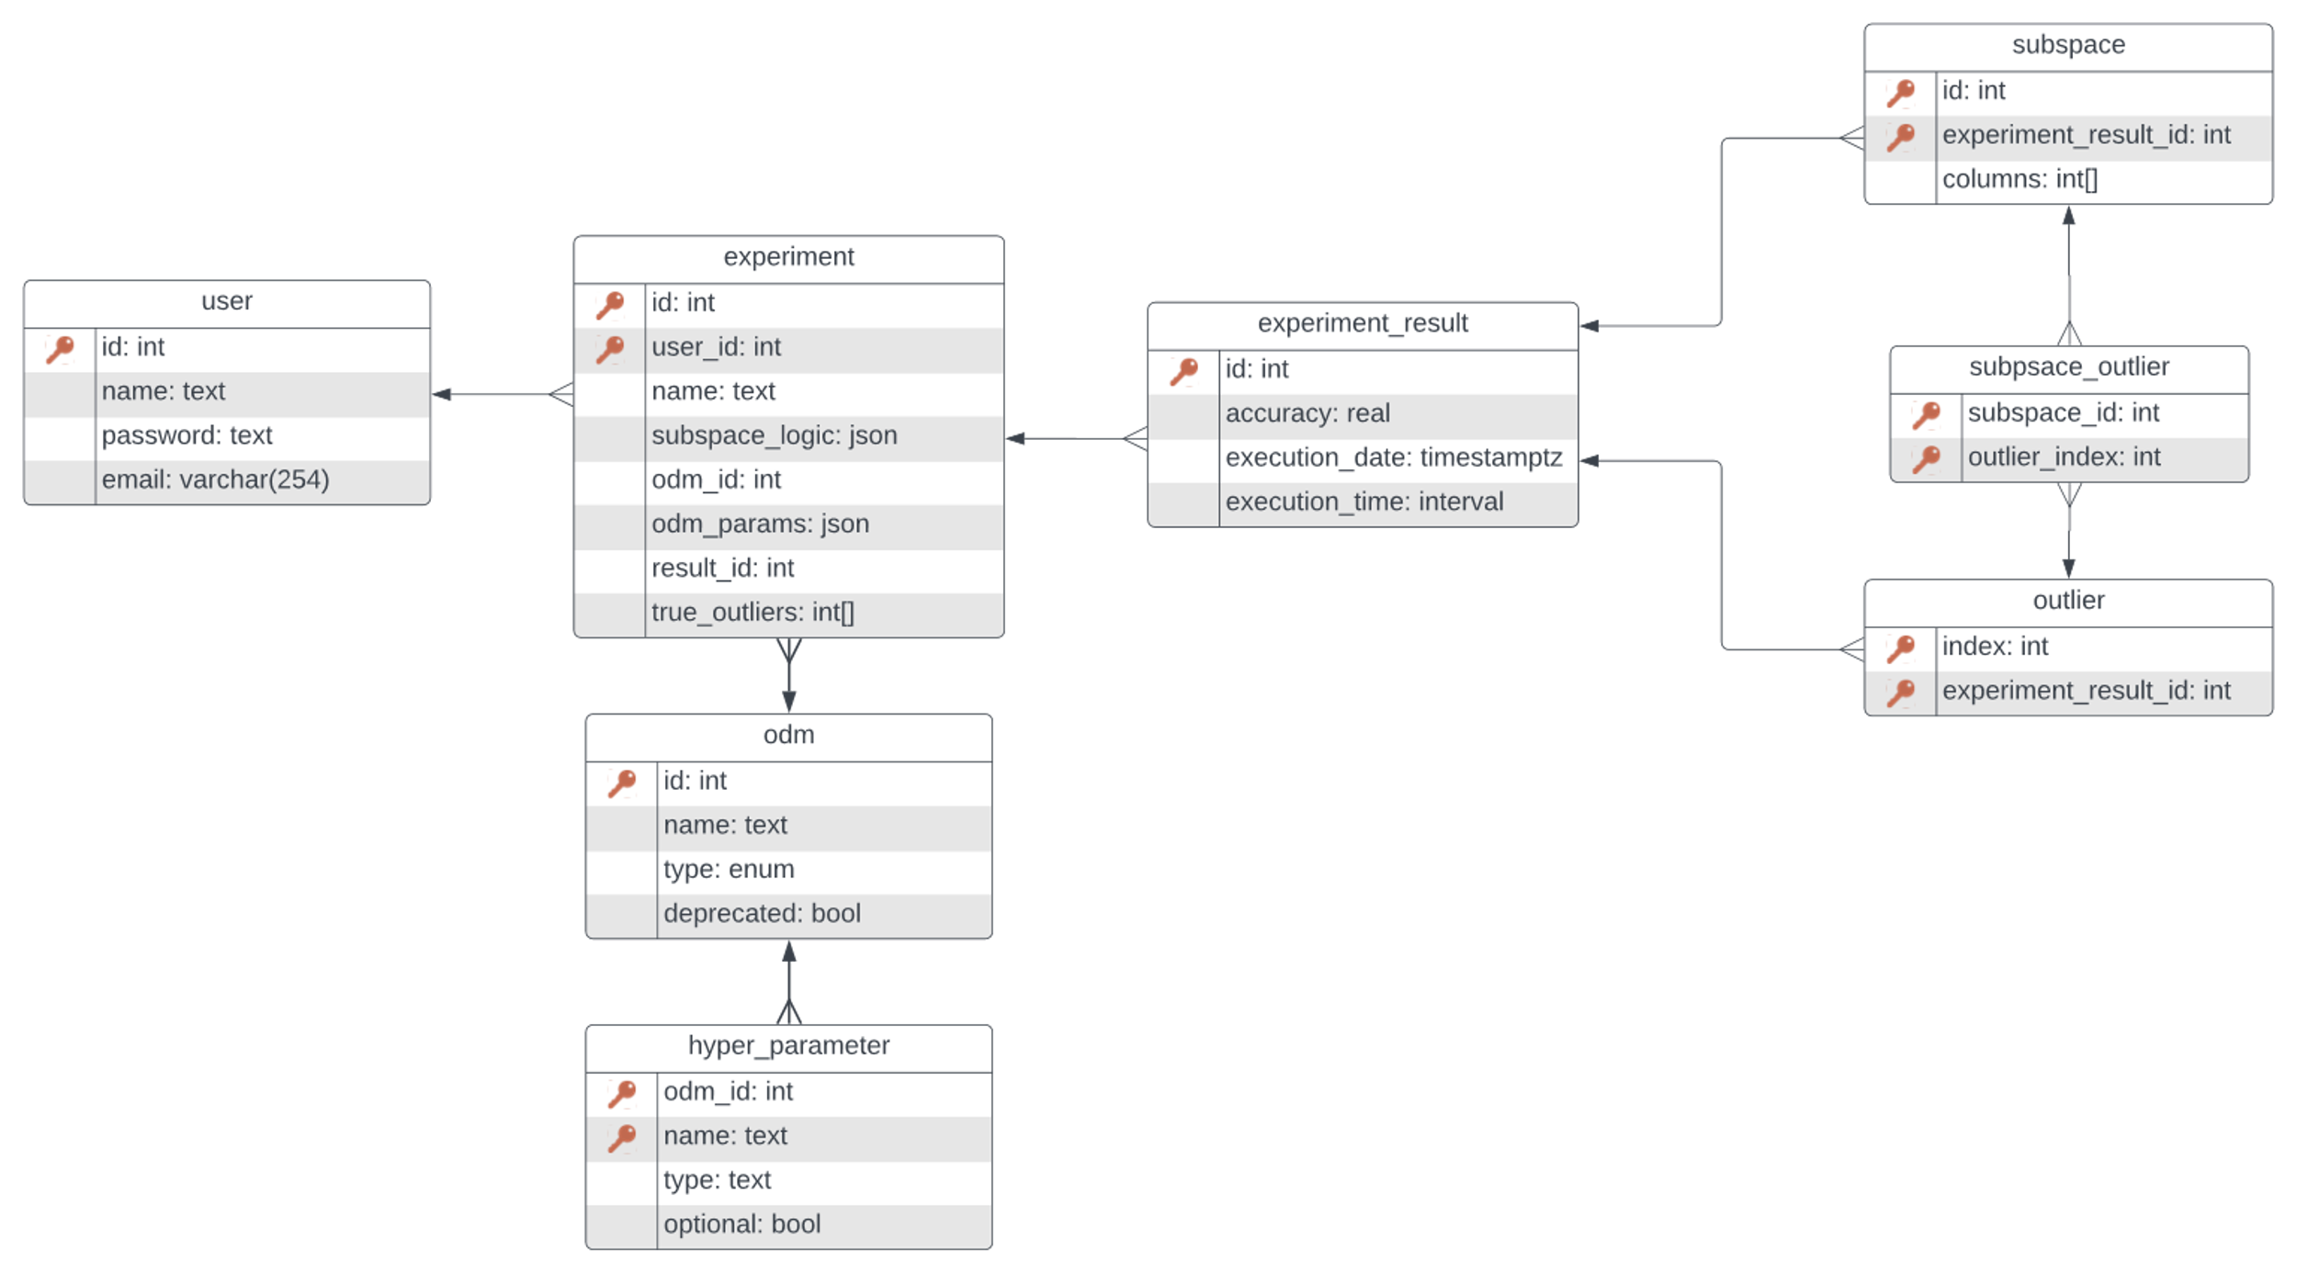
Database

Slide 10
Database

Slide 11
Database

Slide 12
Database

Slide 13
Database

Slide 14
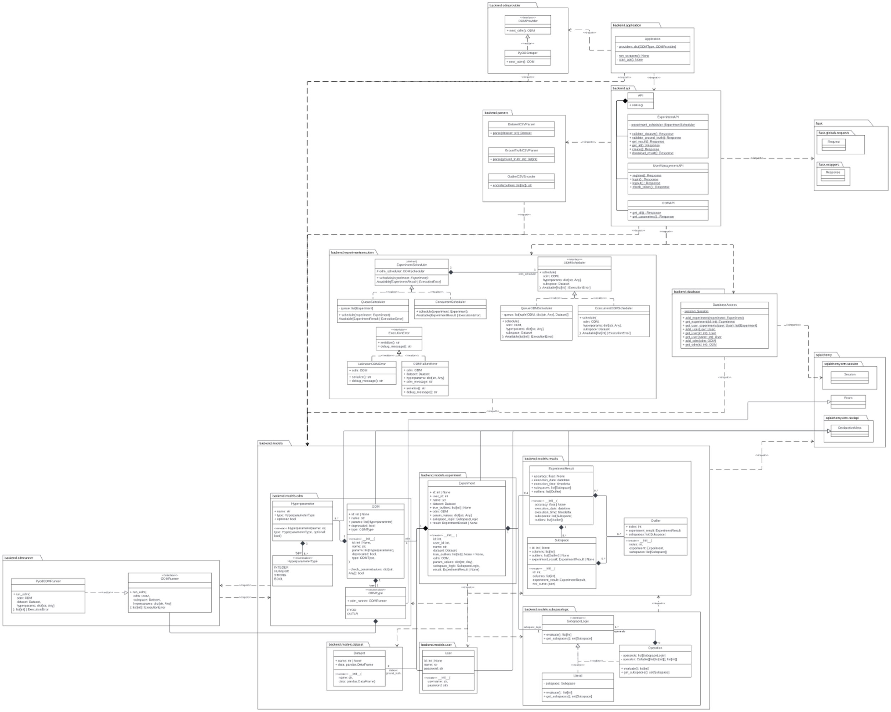
Backend

Slide 15
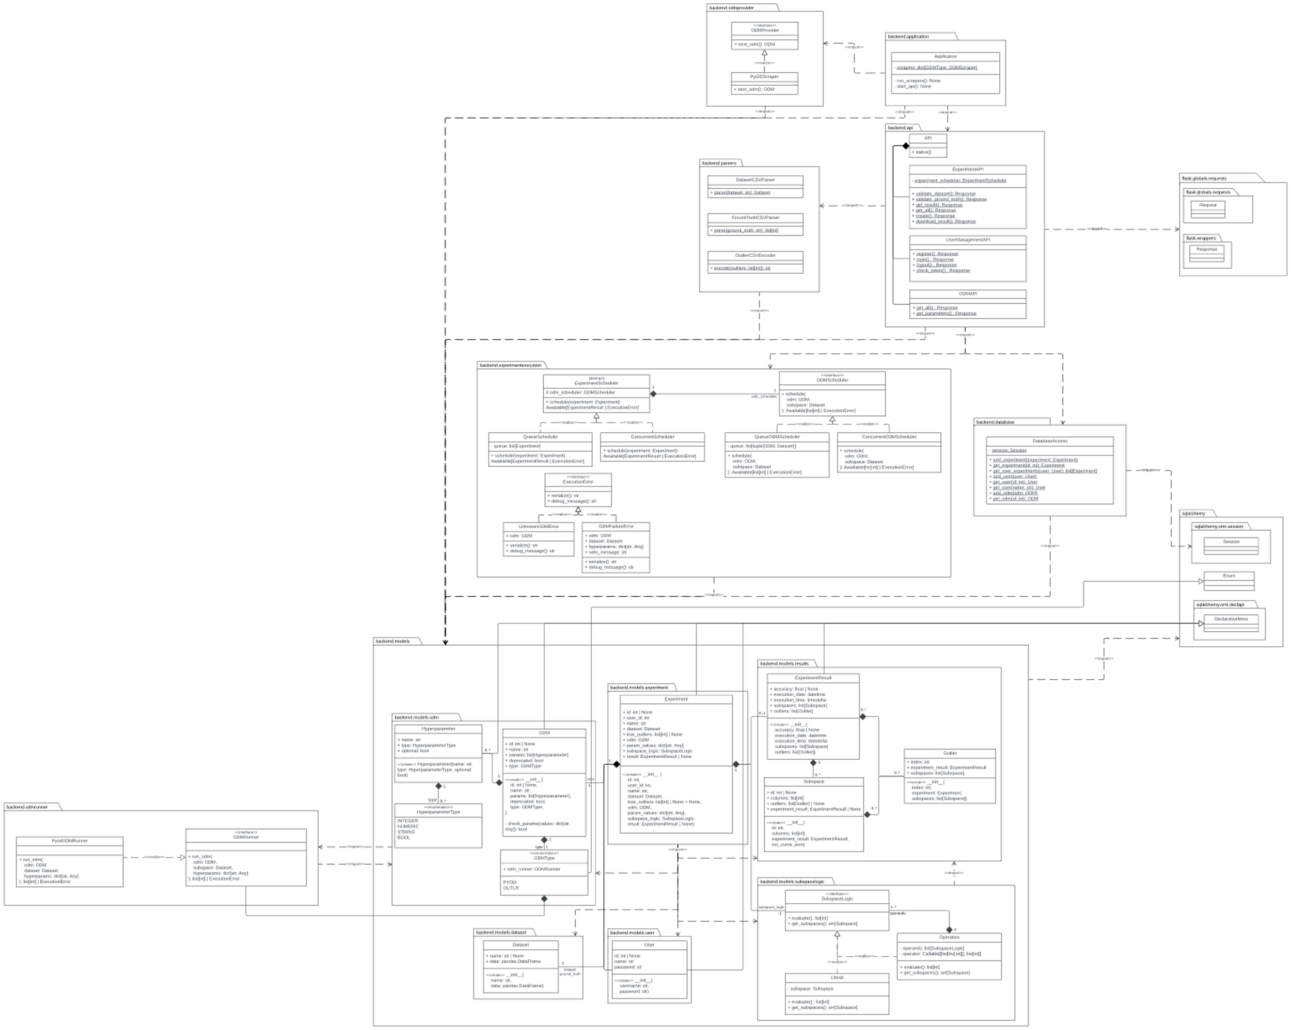
Backend Models

Slide 16
Backend Models

Slide 17
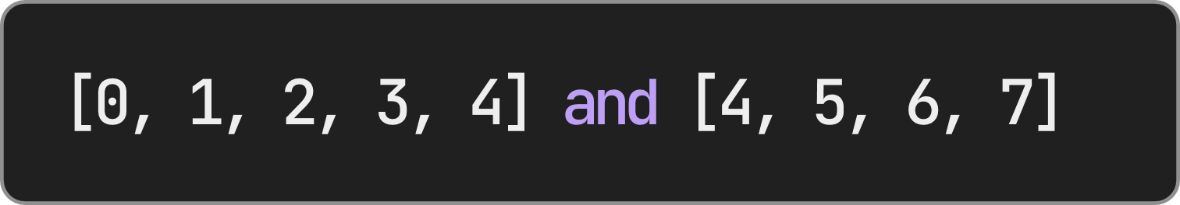
Backend Models
Reminder
Composite Pattern
SubspaceLogic is a tree of Literals and Operations

Slide 18
Backend Models
Adapter Pattern
Allows new kinds of ODMs to be added in the future

Slide 19
Backend Models
SQLAlchemy
Generates database from Python classes

Slide 20
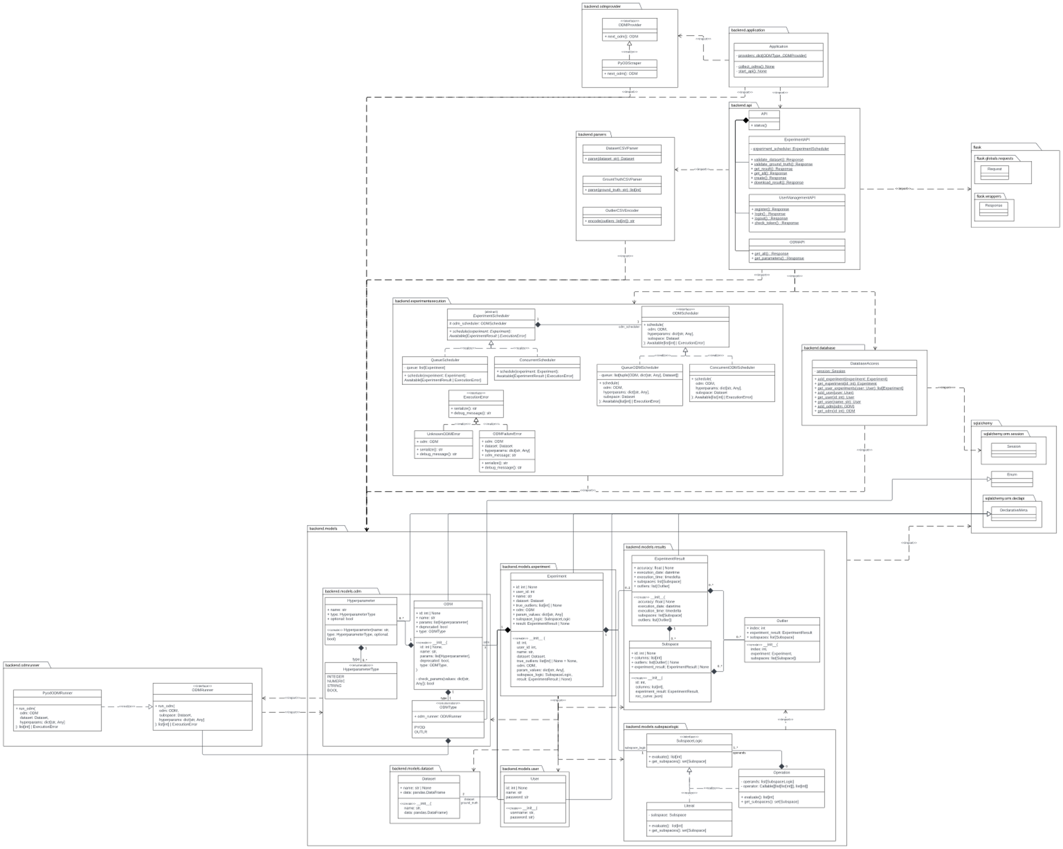
Backend - Application

Slide 21
Backend - Application

Slide 22
Backend - Application

Slide 23
Backend - API
Each method
defines one endpoint

Slide 24
Backend - Database

Slide 25
Backend Experiment Execution
Task
Fair distribution of resources among users
Issue
Can't predict number of users
Solution
2 stage scheduler

Slide 26
Backend Experiment Execution
First stage
Scheduler for experiments

Slide 27
Backend Experiment Execution
Second stage
Scheduler for individual Outlier Detection Algorithms

Slide 28
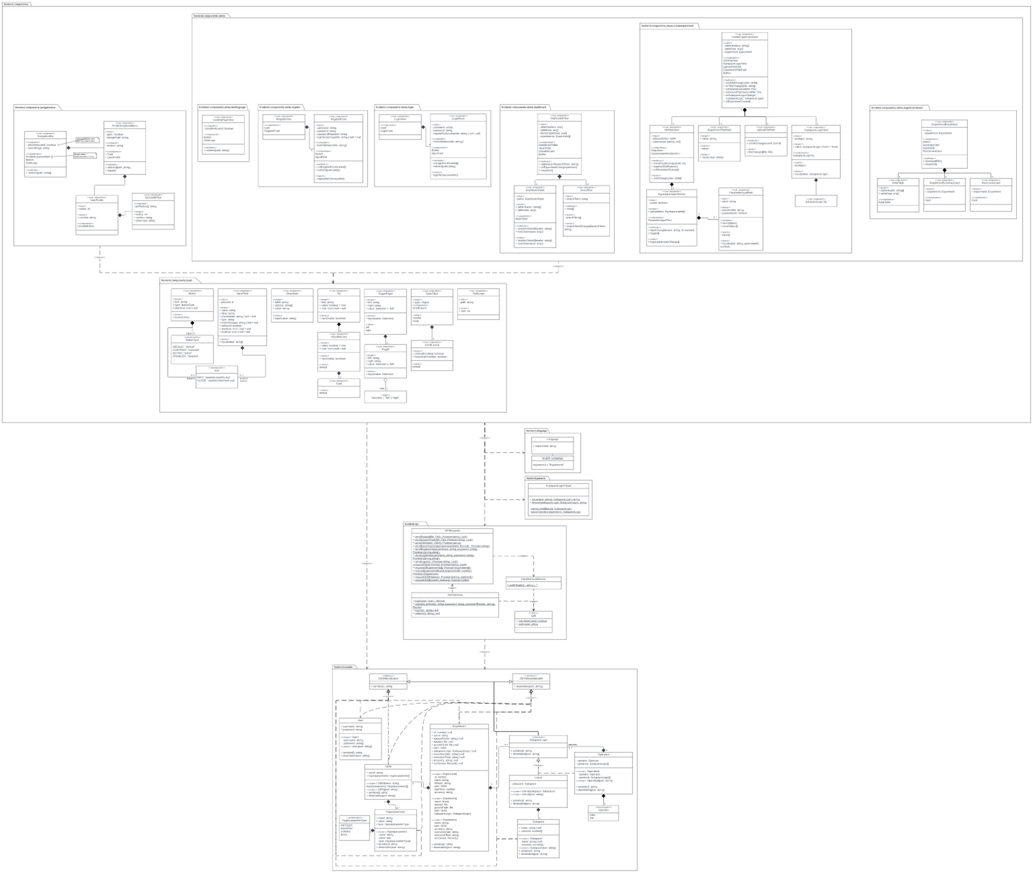
Frontend

Slide 29
Frontend models

Slide 30
Frontend models

Slide 31
Frontend models

Slide 32
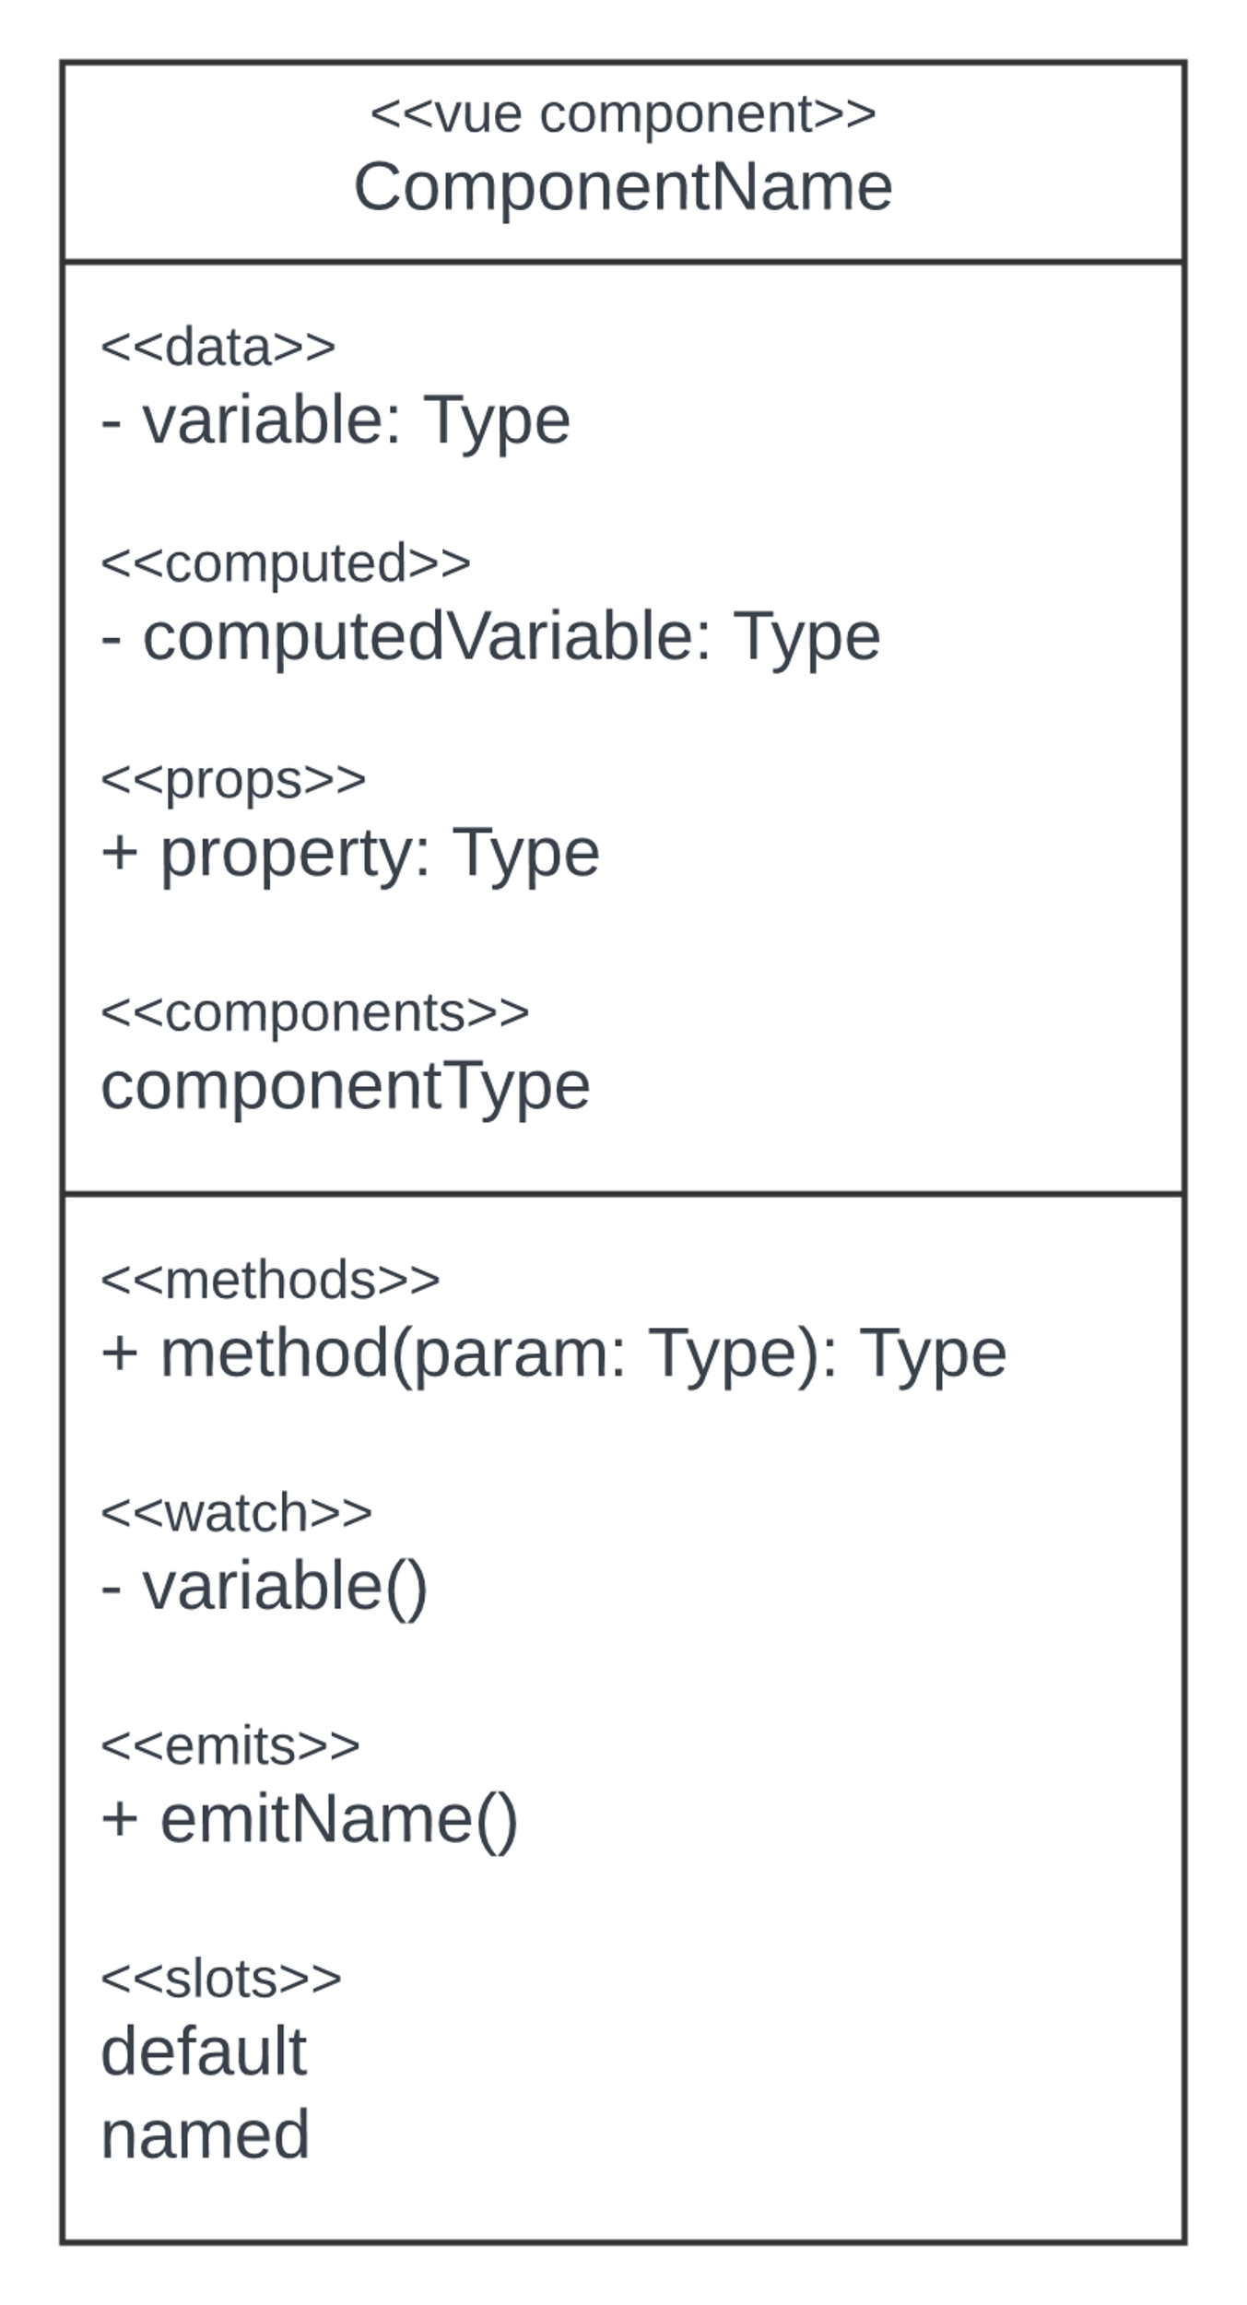
Structure of Component diagrams
Notes:
The framework has a reactive data model, which means that when the data changes, the components that use that data will automatically update to reflect the changes. This allows for real-time updates and a dynamic user interface. Vue.js also has a template-based syntax, which allows developers to easily define the structure and layout of the components using templates written in HTML. This makes it easy to create complex user interfaces using a familiar syntax.
Object-oriented approach to organize and reuse code
Reactive data model: framework observes data and updates the component (powerful feature)
-> in oop state private and can only be changed through defined methods
Template-based syntax: no classes and objects in object oriented sense

Slide 33
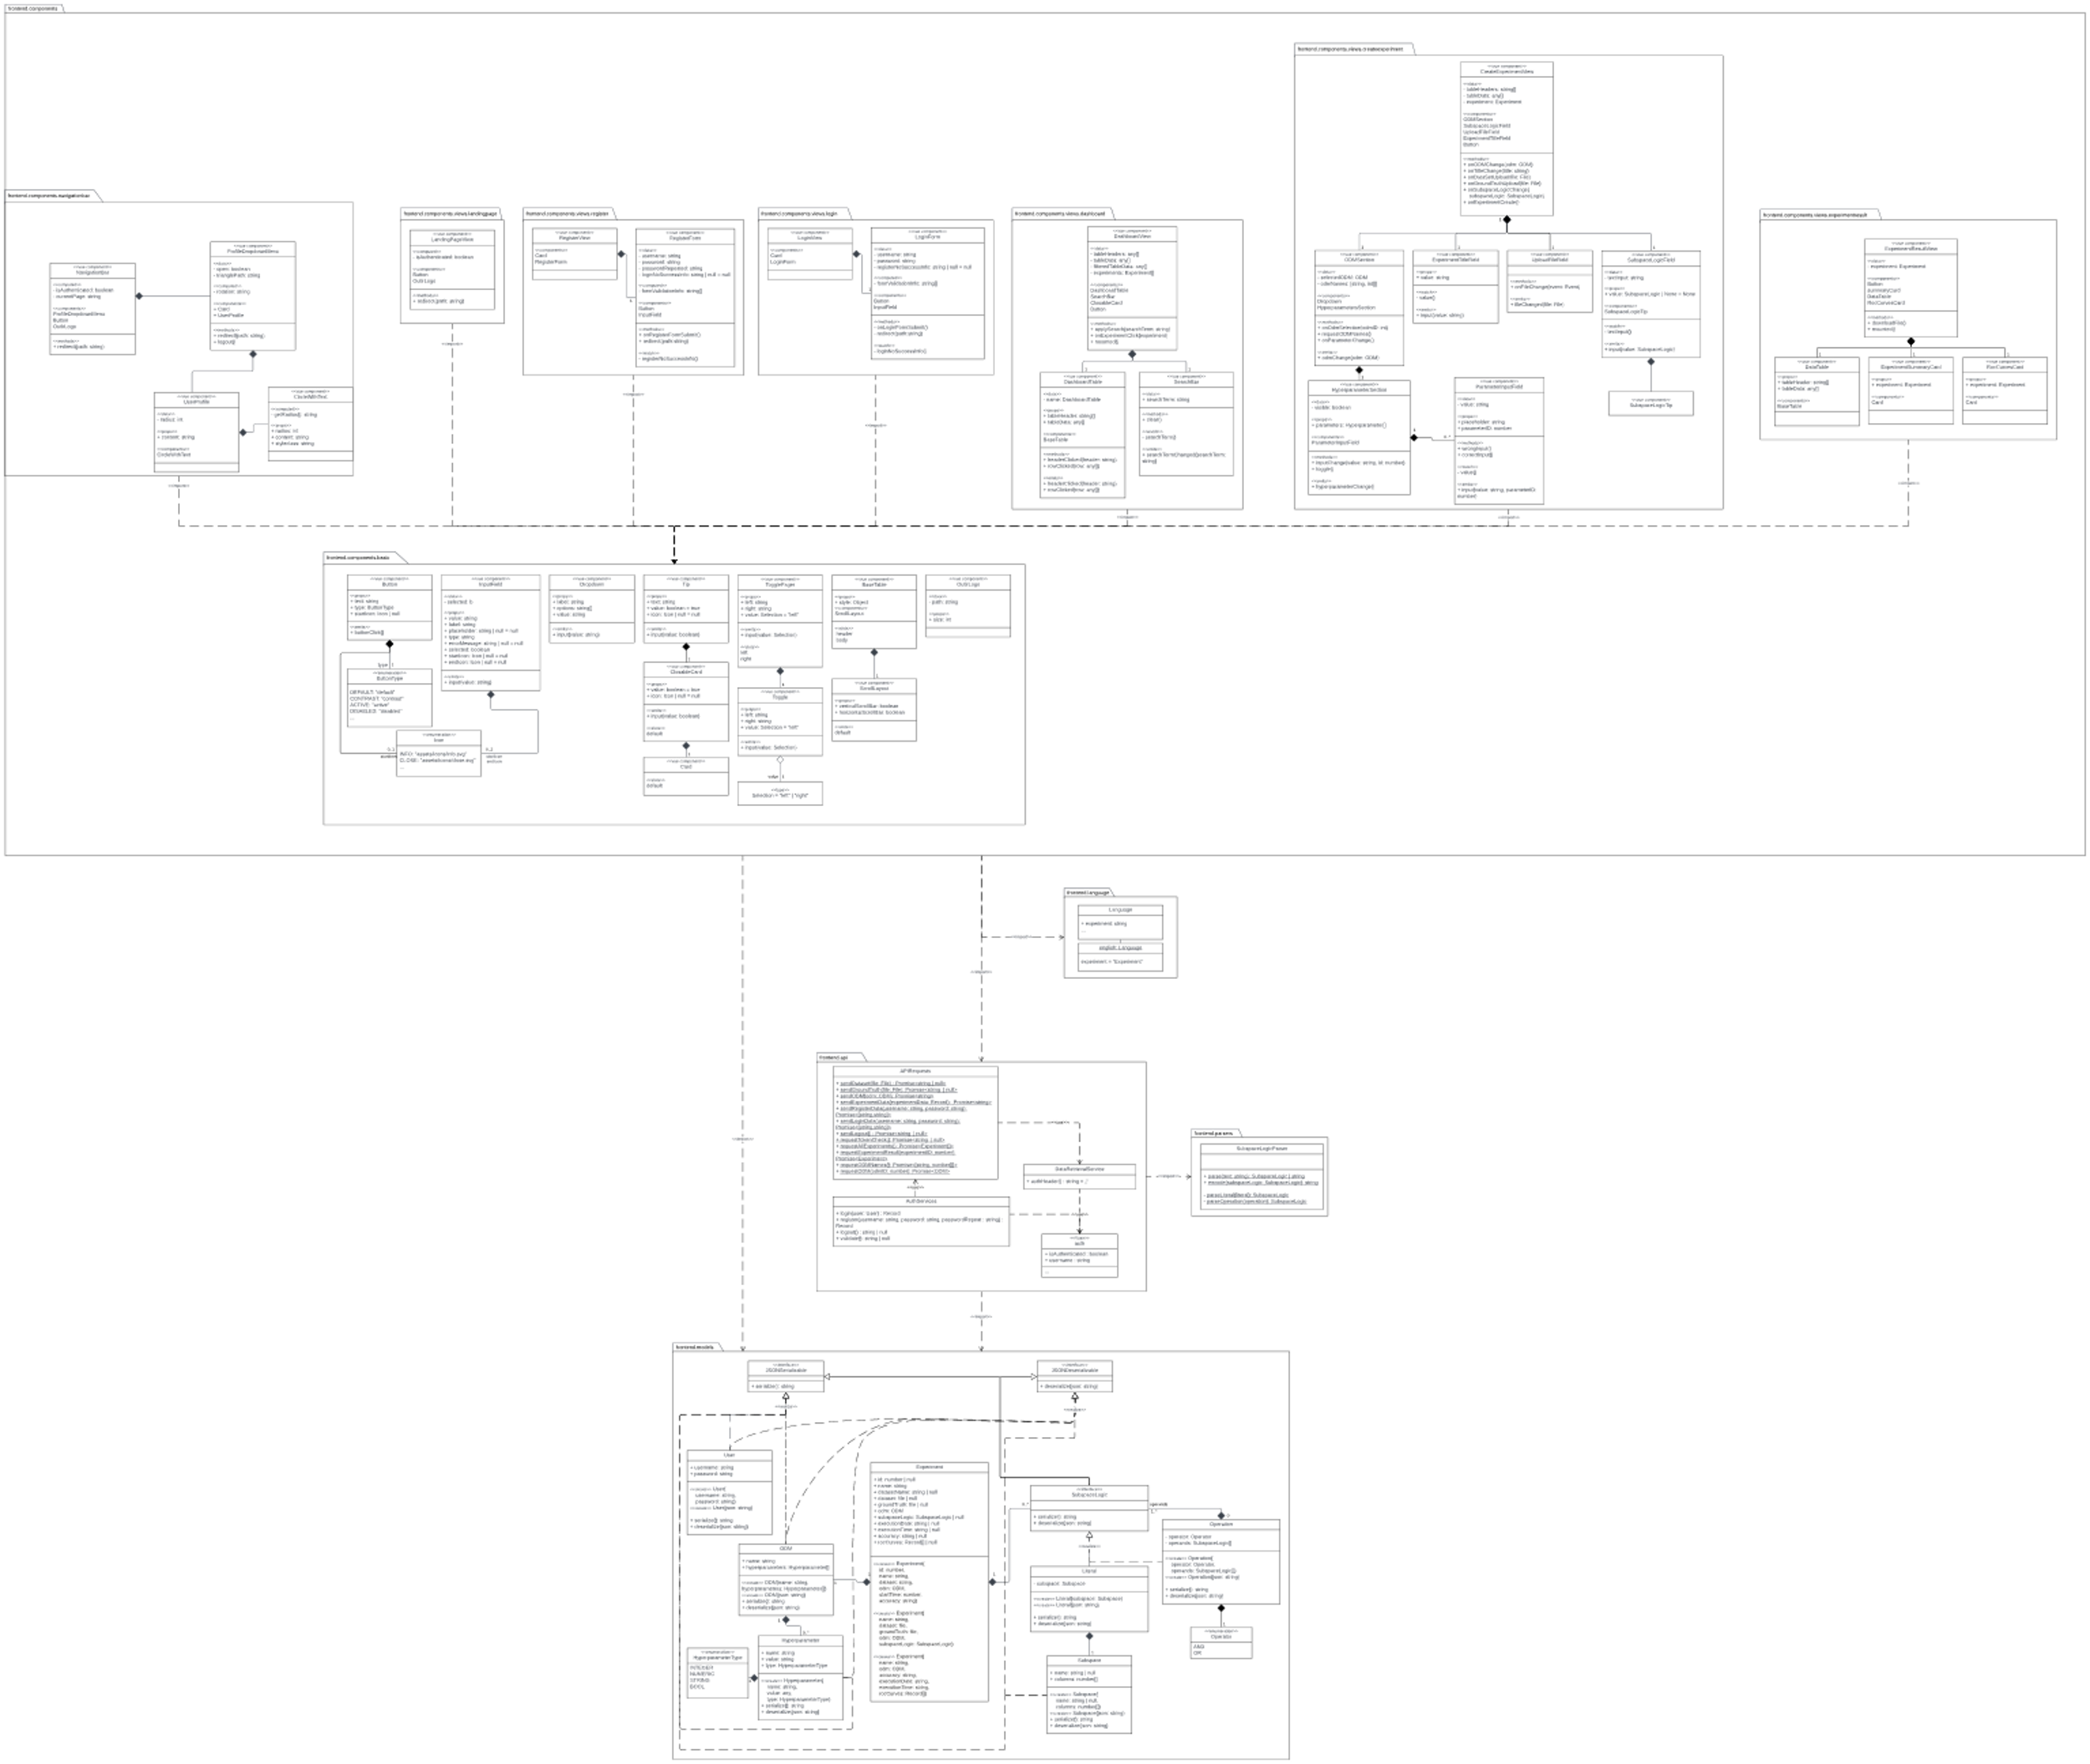
Frontend

Slide 34
Frontend Basic Components

Slide 35
Frontend Basic Components

Slide 36
Frontend Basic Components

Slide 37
Frontend Basic Components

Slide 38
Frontend Basic Components

Slide 39
Frontend
single-page application (SPA)
Vue Router

Slide 40
Frontend Views

Slide 41
Frontend Views

Slide 42
Frontend Views

Slide 43
Frontend Views

Slide 44
Frontend Views

Slide 45
Frontend Views

Slide 46
Frontend Views

Slide 47
Frontend Views

Slide 48
Frontend Dashboard View

Slide 49
Frontend Dashboard View

Slide 50
Frontend Create Experiment View

Slide 51
Frontend Create Experiment View

Slide 52
Frontend Create Experiment View

Slide 53
Frontend Create Experiment View

Slide 54
Frontend Create Experiment View

Slide 55
Frontend Create Experiment View

Slide 56
Frontend Language

Slide 57
Frontend API

Slide 58
Frontend API

Slide 59
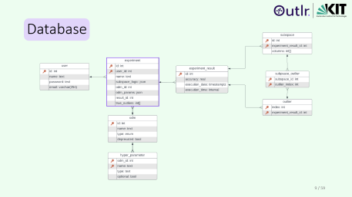
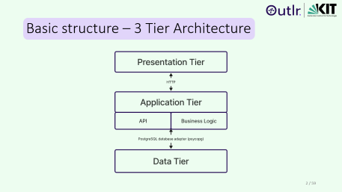
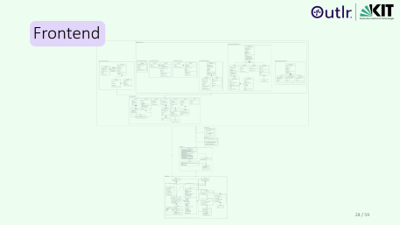
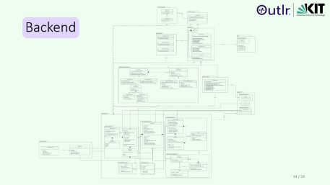
Overview

